Slide 1
Network Assisted Platooning
Maria, filip, Mikael, Gabriel

Slide 2
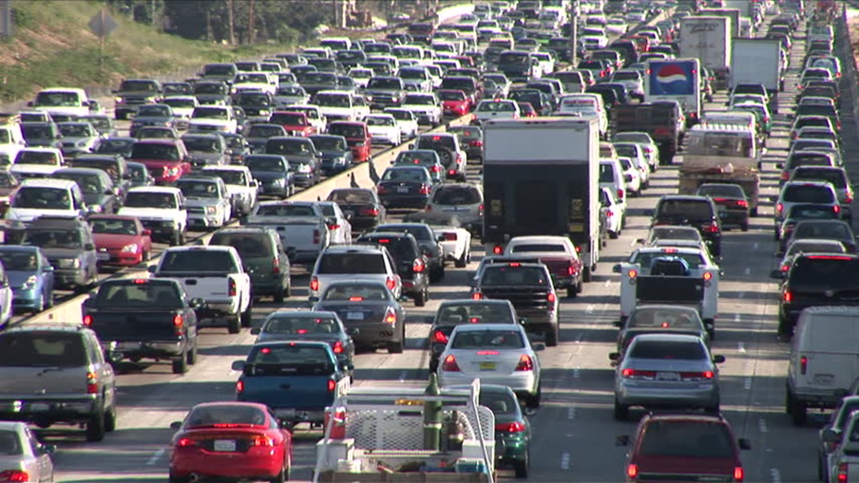
Future
Amount of autonomous vehicles will increase.
Advanced communication technologies.
Imagine no traffic.

Slide 3
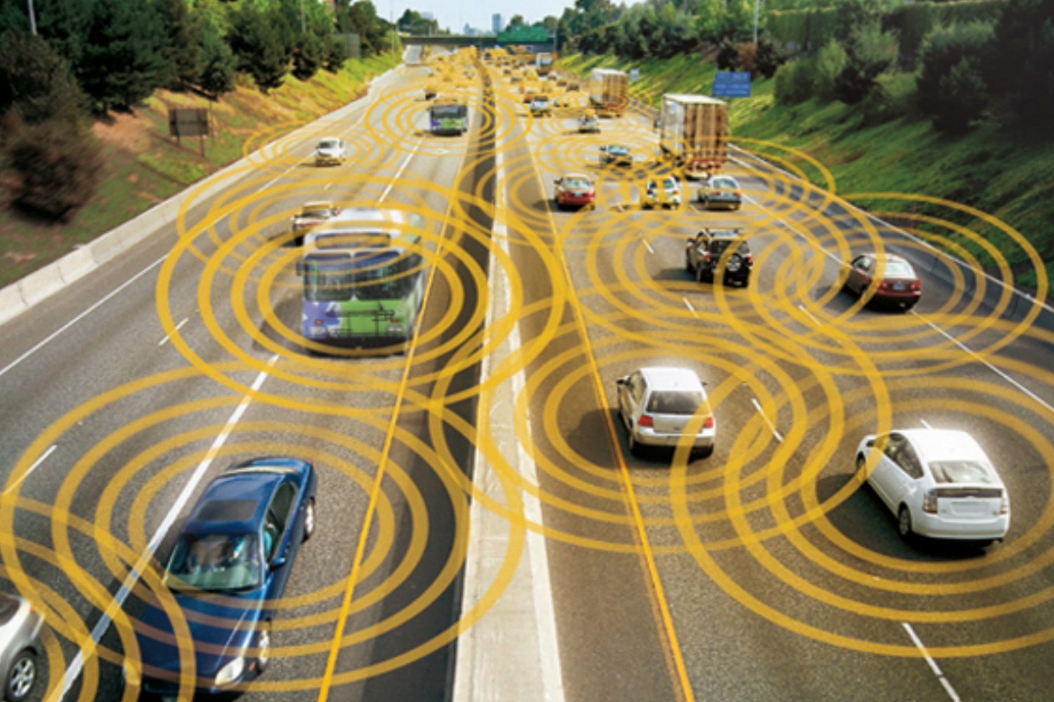
Sharing data
Data generated from the vehicles should be analyzed and shared. Why?
Traffic flow control
Present:
Sensors (Radar, Lidar, Stereo Cameras)
Data used to communicate locally.

Slide 4
Centralised control
Control processes are done locally on the vehicles.
Power demanding.
Emerging technologies makes it possible to migrate heavy computations to external servers.
Data can hence be analyzed and shared in a wider range.
Scalability.
Traffic optimisation.

Slide 5
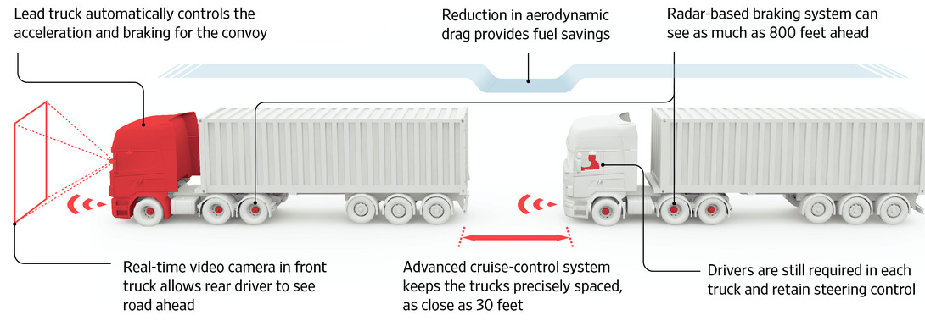
Sustainability
Reducing fuel consumption by drafting.

Slide 6
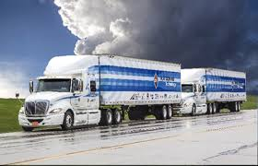
Project description
Networked assisted platooning
- Platooning
- Path following
- Controller design

Slide 7
Communication
ROS, Wifi.
MoCap – publish vehicle position
Controller output is sent through Wifi to Arduino
Centralised controller

Slide 8
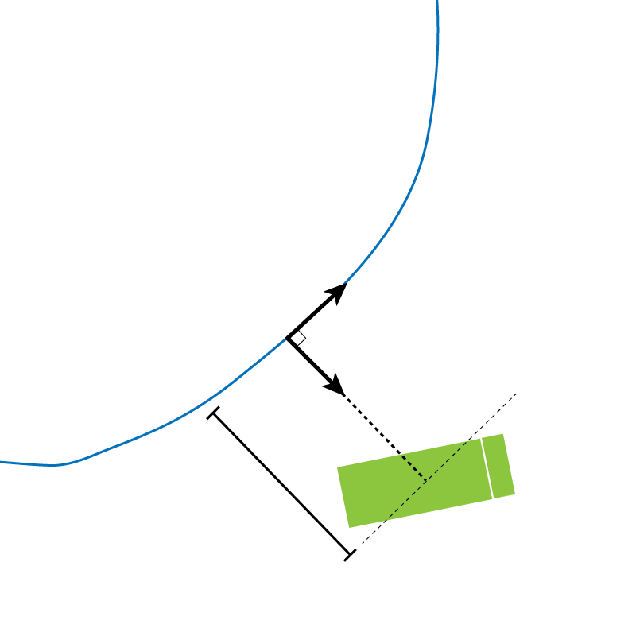
Path tracking
- Frenet frame
- Control orthogonal distance
- Feedback linearization and PID.

Slide 9
PID
PID control has been implemented for distance regulation as well.
The error which is minimized is the relative time difference between the trucks.

Slide 10
Lessons learned
Better model of the truck earlier on.
Looked into other control methods.

